Slide 1

ECE 591 CAPSTONE PROJECT
Team 7

Slide 2




Cyber
Threats
Systems
Network
Malware
Phishing
Ransomware
Notes:
Cyberthreats are malicious acts targeting digital systems and networks
It can cause damage, disrupt operations, or steal information.
These threats include a wide range of attacks, including malware, phishing, ransomware, and social engineering, among others.
One of the biggest threat is the phishing attack.
And today, we are going to talk about the phishing emails provided by Uvic.

Slide 3
Phishing Email and Prevent
What’s phishing?
Use fraudulent emails, texts, or websites to steal private data, such as bank account information and login credentials.
Extract meaningful patterns to analyze the phishing email subjects, bodies and attachments. Then implement real-time detection in the email gateway.
How to prevent?
How to extract patterns?
The solution is to use a combination of machine learning (ML) and deep neural network (DNN) techniques. ML and DNN could handle unstructured, complex, and evolving data.
Advantages of ML and DNN?
ML and DNN’s advantages include high accuracy and automation threat mitigation, making them more effective than traditional methods at identifying phishing email patterns.
Notes:
Phishing involves using fraudulent emails, texts, or websites with the aim of stealing private data, such as bank account information and login credentials.
One of the ways to prevent phishing email is to Extract meaningful patterns of the phishing email, including subjects, bodies and attachments. Then implement real-time detection in the email gateway.
We talked about the patterns, but how to extract them? The effective solution is to use a combination of machine learning (ML) and deep neural network (DNN) techniques. ML and DNN could handle unstructured, complex data.
ML and DNN’s advantages include high accuracy and automation, making them more effective to traditional methods for extract the phishing email patterns.

Slide 4
ML and DNN
ML-Machine Learning
DNN-Deep Neural Network
Machine learning (ML) enables computers to learn from data and make predictions or decisions without explicit programming.
By identifying patterns and relationships within large datasets, ML algorithms—such as decision trees, support vector machines, or neural networks—can perform tasks like classification, regression, and clustering.
Deep Neural Networks (DNNs) consisting of multiple interconnected layers of artificial neurons that process data to uncover complex patterns and representations. Unlike traditional algorithms, DNNs automatically extract hierarchical features from raw inputs, such detecting phishing emails by analyzing contextual nuances or classifying malware from raw binaries.
Why ML and DNN is suitable for pattern extraction?
Handling Unstructured and Complex Data: Phishing emails contain unstructured text (subjects, bodies, URLs) with diverse formats, languages, and obfuscation
Adapting to Evolving Threats: Phishing tactics constantly evolve (e.g., new lures, domains, or spear-phishing), rendering static rules or signatures obsolete.
Scalability for Large Volumes: Organizations receive millions of emails daily, making manual analysis or simple filtering impractical.
Notes:
Why Machine learning? - Machine learning (ML) enables computers to learn from data and make predictions or decisions without explicit programming.
And DNN onsisting of multiple interconnected layers of artificial neurons that process data to uncover complex patterns and representations. - which can automatically extract features from the emails.
Why ML and DNN is suitable for pattern extraction?
Handling Unstructured and Complex Data
Adapting to Evolving Threats
Scalability for Large Volumes

Slide 5
Pattern Extract Workflow
Ingest data
Collect raw data, including subjects and bodies, from sources like organizational mail servers.
Preprocess
Clean and normalize email text, removing stop words, and handling special characters or HTML tags.
Extract features
Transform text into numerical representations like TF-IDF vectors to capture phishing indicators.
Train model
Train a machine learning model with labeled phishing and legitimate email data.
Deploy
Integrate the trained model into a production environment for real-time phishing detection.
Monitor
Continuously improve the model’s accuracy, false positives, and detection rates, retrain the modelto adapt to new phishing tactics.
Notes:
There are 6 steps in our workflow.
Ingest data - which is to collect raw data, including subjects and bodies, from sources like organizational mail servers
Preprocess - Clean and normalize email text, removing stop words, and handling special characters or HTML tags.
Extract features - Transform text into numerical representations like TF-IDF vectors or word embeddings to capture phishing indicators.
Train model - Train a machine learning model with labeled phishing and legitimate email data.
Deploy - Integrate the trained model into a production environment, such as a SIEM system or email filter, for real-time phishing detection.
The last step is monitor - we need to Continuously evaluate the model’s accuracy, false positives, and detection rates, retraining as needed to adapt to new phishing tactics.

Slide 6
Descriptive Analysis of the Dataset
Number of Samples
The dataset have 2576 records, with 5 empty subject and 109 empty body emails
Email Outside UVic System
There are 993 emails from outside of the UVic email system
Number of Keywords
We use NLTK (Natural Language Toolkit) to remove stopwords, and we got 19166 keywords from the body and 2443 keywords from the subject of emails.
Notes:
Talking about the phishing email dataset we got.

Slide 7
STEPS PERFORMED
Imported and loaded the dataset.
Cleaned and standardized the data.
Analyzed presence of hyperlinks.
Performed descriptive analysis.
a) Word Cloud and key-word count
b) Text length Analysis
c) Link Presence Analysis

Slide 8
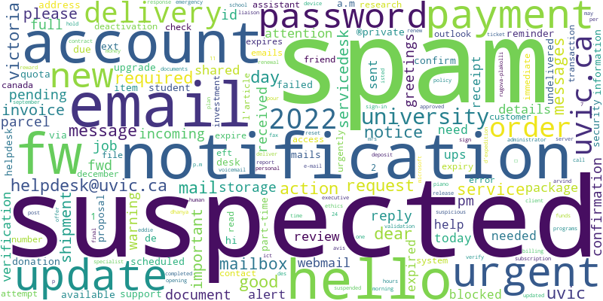
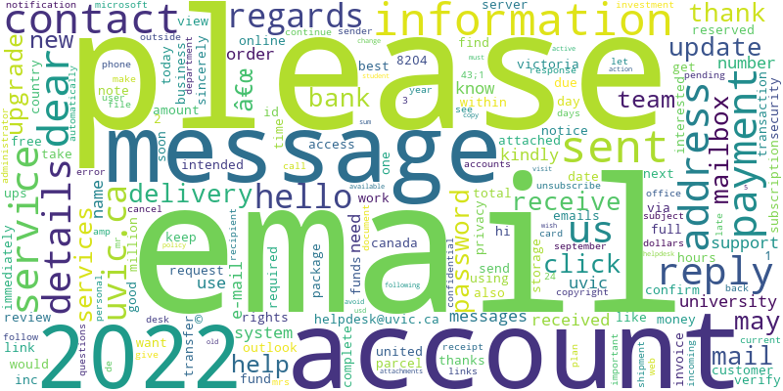
Descriptive Analysis - Word Cloud
Word cloud for the Subject of the email
Word cloud for the Body of the email

Slide 9
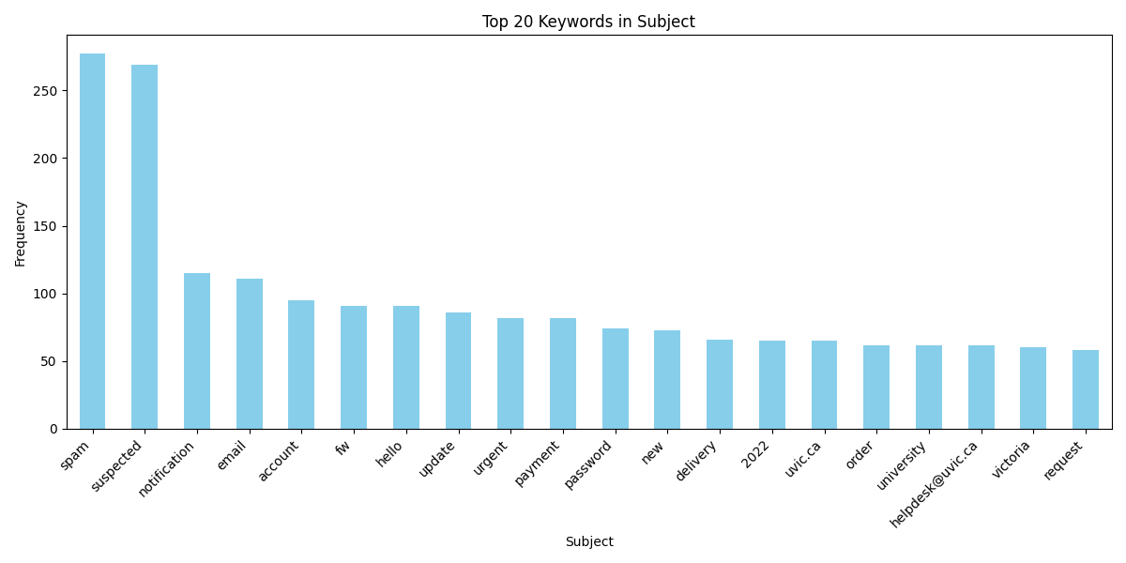
Descriptive Analysis - keyword count

Slide 10
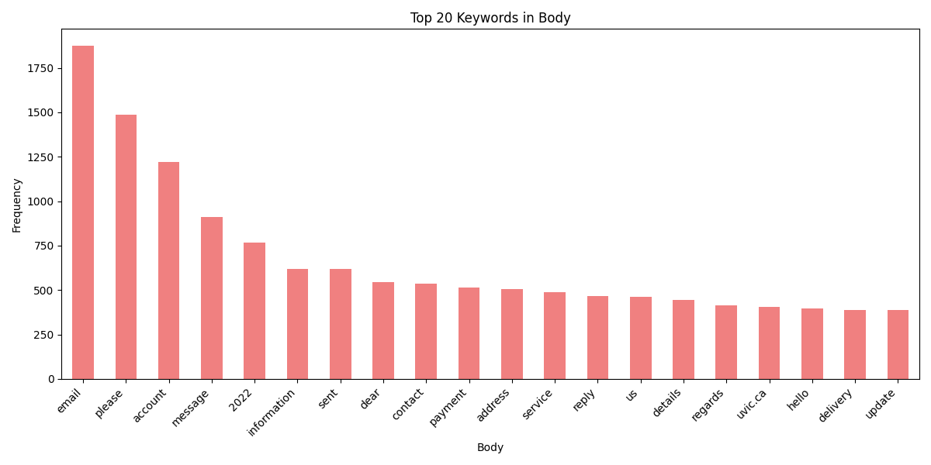

Slide 11
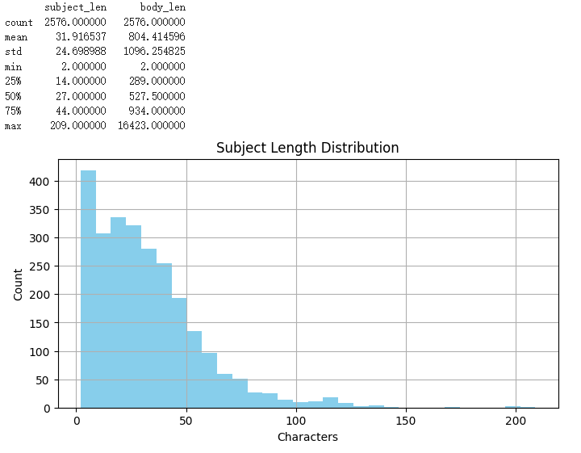
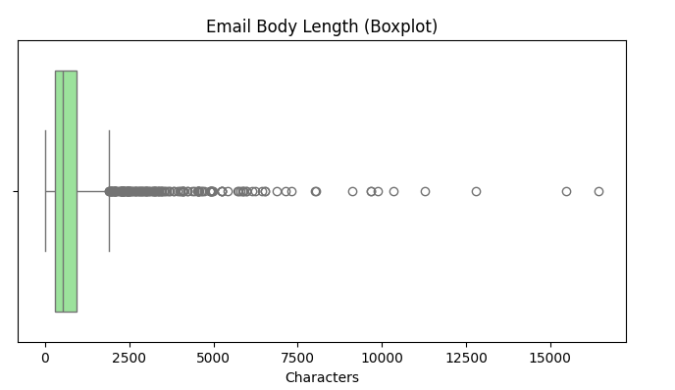
Descriptive Analysis - Text Length Analysis

Slide 12
Observations:
Most email subjects are relatively short, with over 75% under 50 characters.
Email bodies show high variability, with some reaching extremely large lengths—up to over 16,000 characters.
The boxplot for body length shows many outliers, indicating some emails may contain unusually verbose content, which could be auto-generated or intentionally overwhelming.
Descriptive Analysis - Text Length Analysis

Slide 13
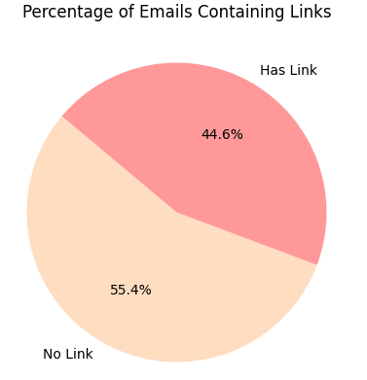
Descriptive Analysis - Link Presence Analysis
Observations:
Nearly half of all emails include hyperlinks, which is a common characteristic of phishing emails.
This suggests that link presence is a strong candidate feature for downstream classification models or detection rules.

Slide 14
References
Team, I. C. (2024, March 25). Cyberthreats types. Types of cyberthreats. https://www.ibm.com/think/topics/cyberthreats-types
V. Zeng, S. Baki, A. El Aassal, R. Verma, L. F. T. De Moraes, and A. Das, ―Diverse datasets and a customizable benchmarking framework for phishing,‖ IWSPA 2020 - Proc. 6th Int. Work. Secur. Priv. Anal., no. Section 3, pp. 35–41, 2020, doi: 10.1145/3375708.3380313.
Abraham, Achsah. Comparative Analysis of Deep Learning Models for Predictive Phishing Attacks and Virus Message Forecasting. Diss. The George Washington University, 2024.
Sarker, Iqbal H., et al. "Cybersecurity data science: an overview from machine learning perspective." Journal of Big data 7 (2020): 1-29.

